Slide 1
Product Icons
June 2010

Slide 2
Summary
Product Icons
Brief Explanations of each product
Locations of Product Icons in product GUIs

Slide 3
Product Icons

Slide 4








End User Facing Icons
Receiver HDX – Online plugin Accelerator Easy Call
Dazzle DocFinder Access Gateway Password manager

Slide 5




Admin Facing Icons – Major products
XenDesktop XenApp XenServer
Access Gateway NetScaler XenClient

Slide 6









Admin Facing Icons – major features and sm. products
Provisioning server Power Management XenServer Essentials Edgesight (Metering)
Delivery Console Access Essentials Licensing Workflow Studio XenVault

Slide 7
What do they do?

Slide 8
Product explanations
I owe you, these – for now review the marking material on www.Citrix.com

Slide 9
Locations in GUIs

Slide 10
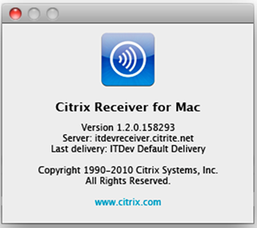
About

Slide 11
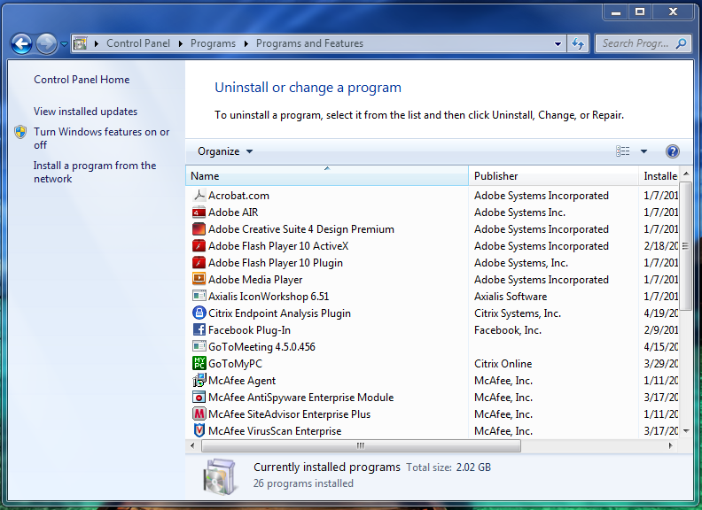
Add/Remove

Slide 12
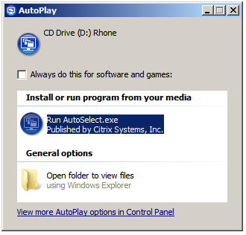
Auto Play

Slide 13
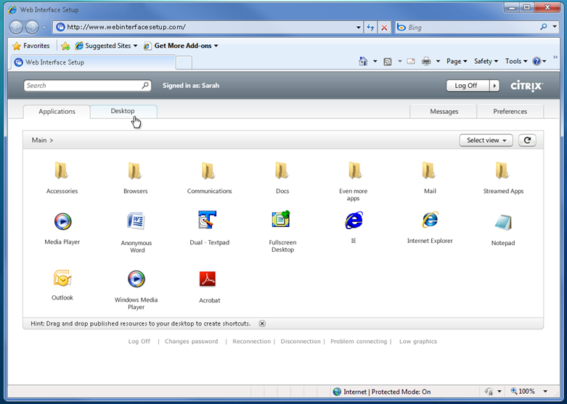
Browser – Favicon – Web Tab
Browser
Favicon
Web Tab

Slide 14
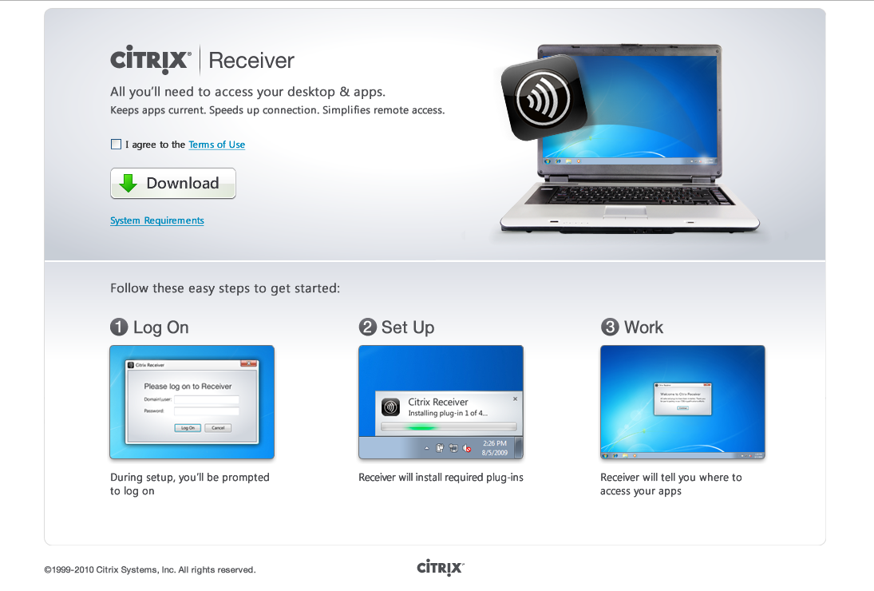
Download
Notes:
Reduce icon size
Menu should be centered below top text area.

Slide 15
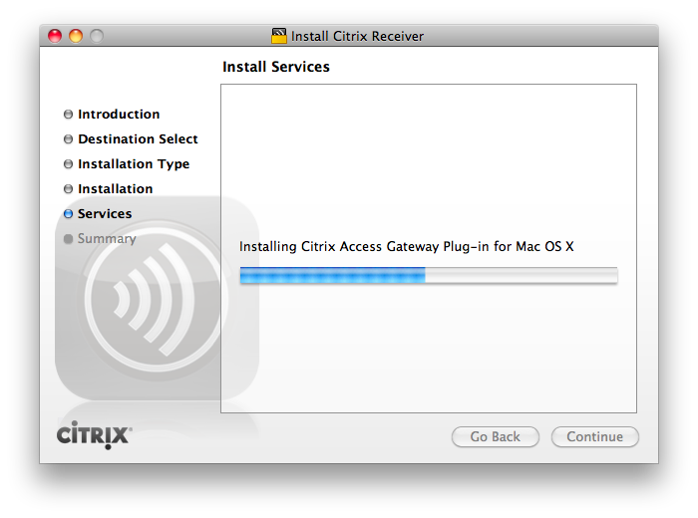
Embedded into Image
Notes:
Reduce icon size
Menu should be centered below top text area.

Slide 16
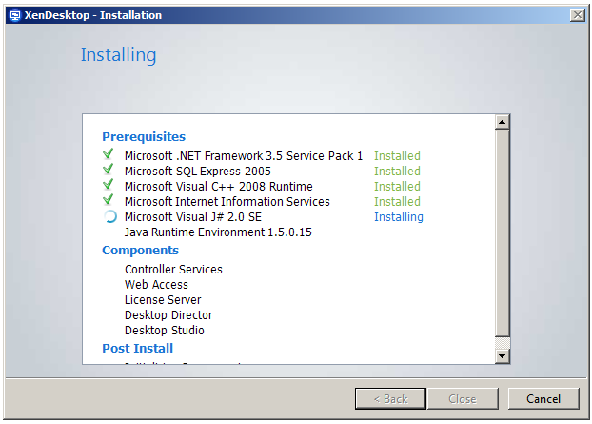
Install 1

Slide 17
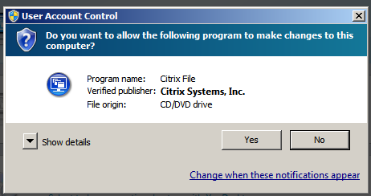
Install 2

Slide 18
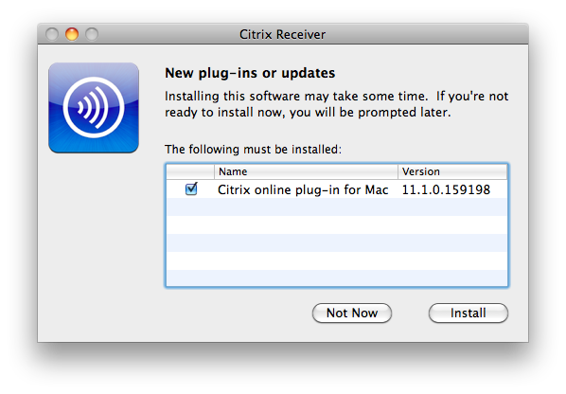
Install Mac

Slide 19
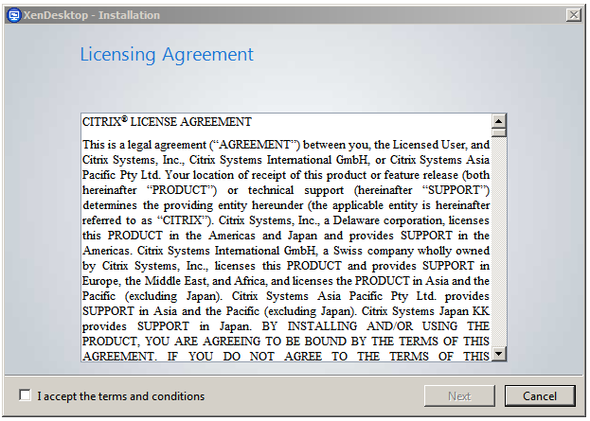
Licensing

Slide 20
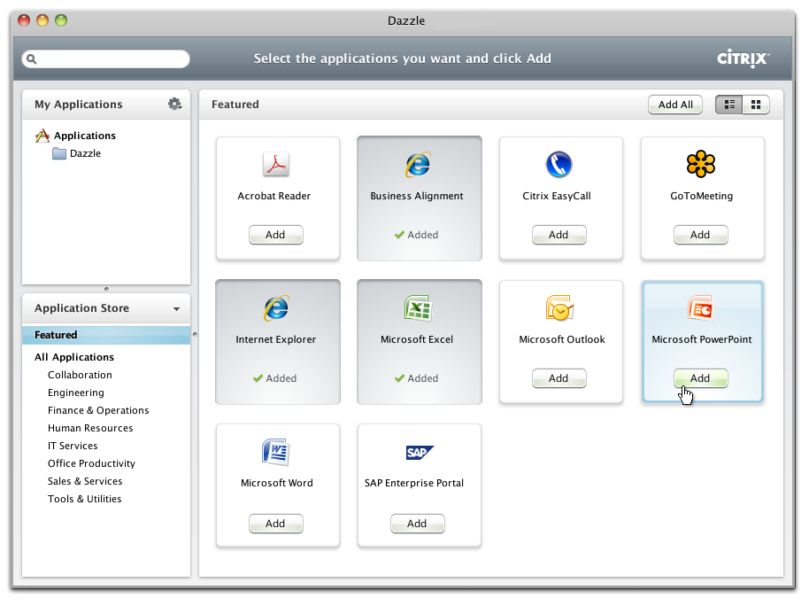
Menu?

Slide 21
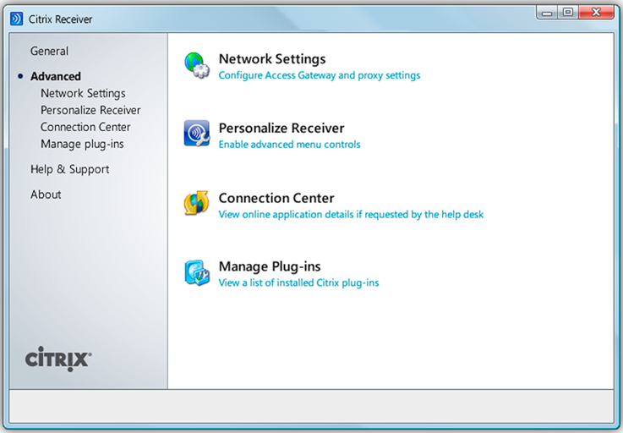
Settings - Title

Slide 22
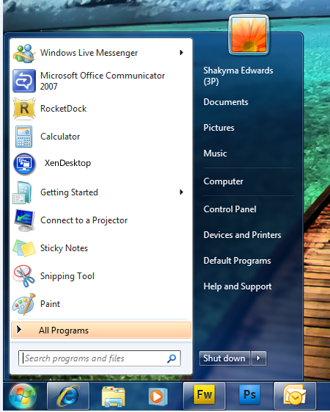
Start Menu

Slide 23
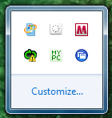
Systems Tray

Slide 24
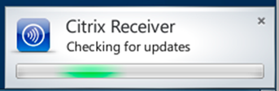
Toaster Pop

Slide 25
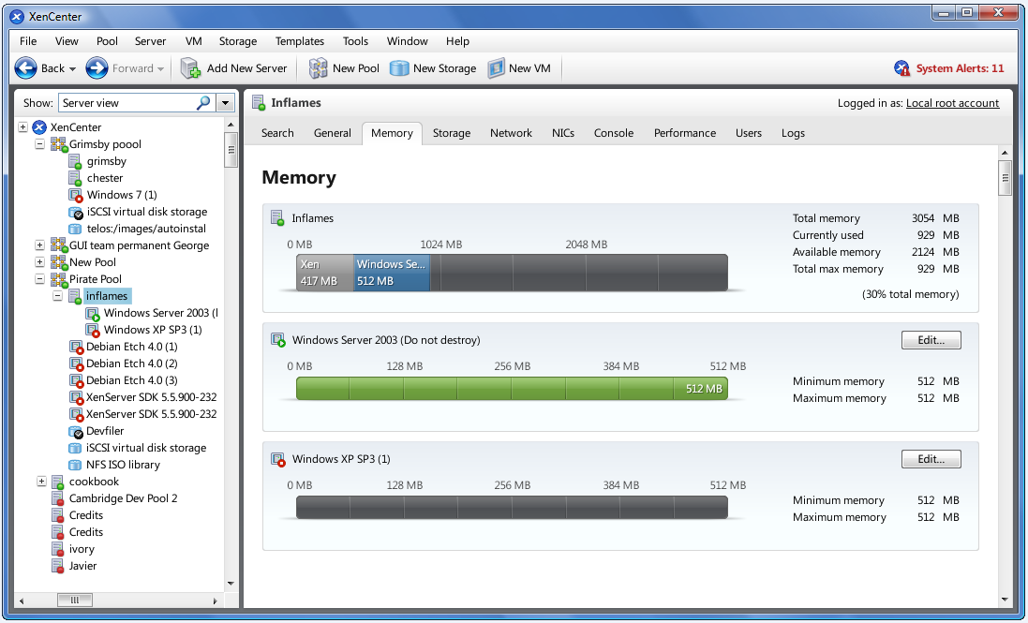
Tree – Title - Error
Title
Error
Tree

